Slide 1
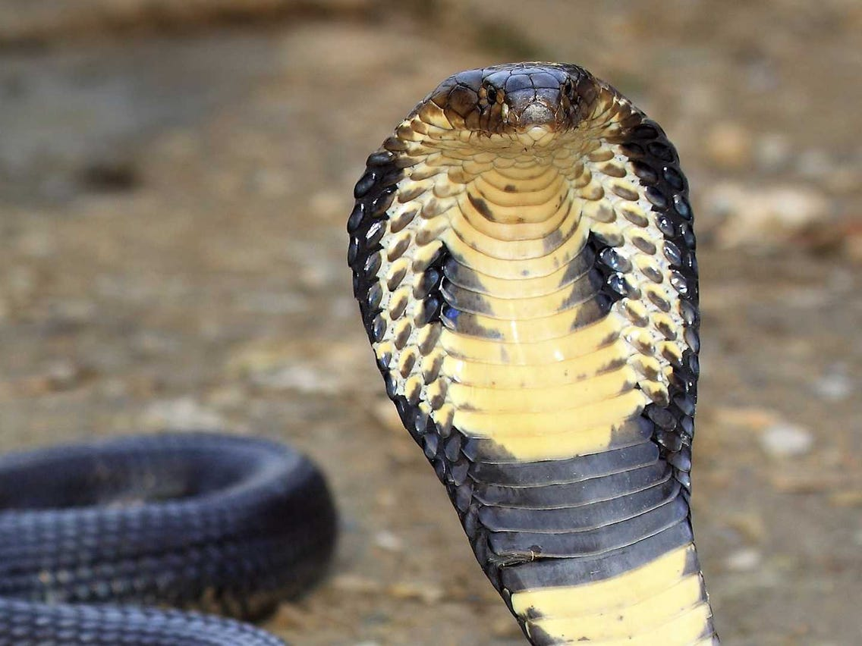
KING COBRAS
King cobras are cold-blooded reptiles. They are the longest venomous snake in the world

Slide 2
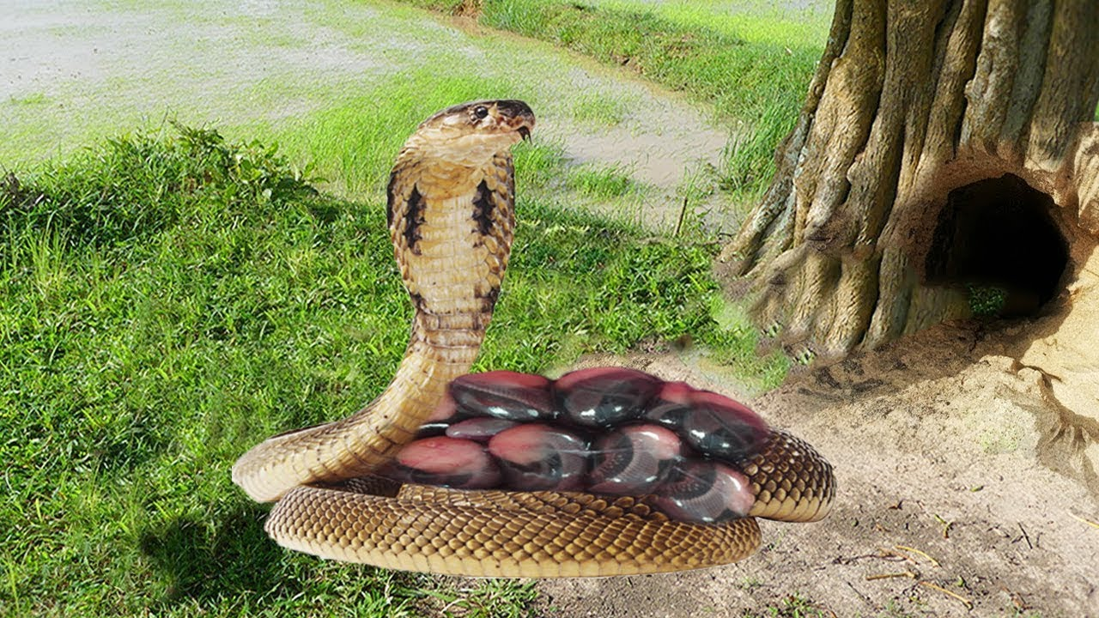
WHERE THEY LIVE
King cobras live in southern China, south-east Asia and in rainforests. They lay eggs in holes and rocks.

Slide 3
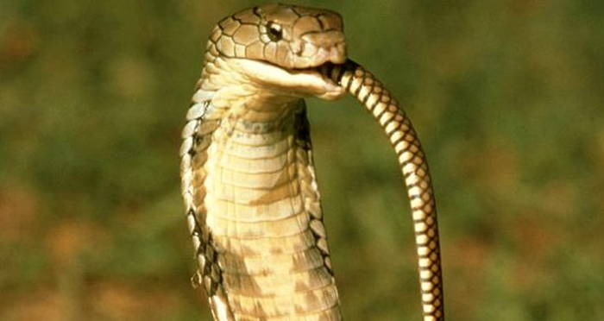
ARE KING COBRAS CANNIBALS?
King Cobras Are Cannibals. With the ability to grow up to 18 feet long, the venomous king cobra can raise a third of its body and look a human in the eye. While that might sound impressive, what really makes these snakes king is their diet: other snakes.

Slide 4
THE FOOD THAT THEY EAT
King cobras eat lizards, eggs and small mammals+ other snakes

Slide 5
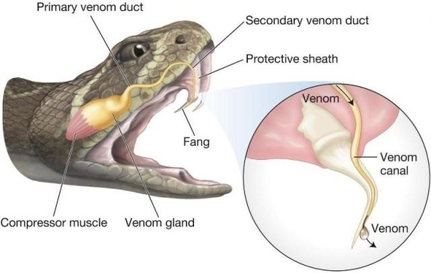
THEIR VENOM
King cobras venom is not the most potent among venomous snakes, but the amount of neurotoxin they can deliver in a single bite is enough to kill 20 people, or even an elephant.

Slide 6
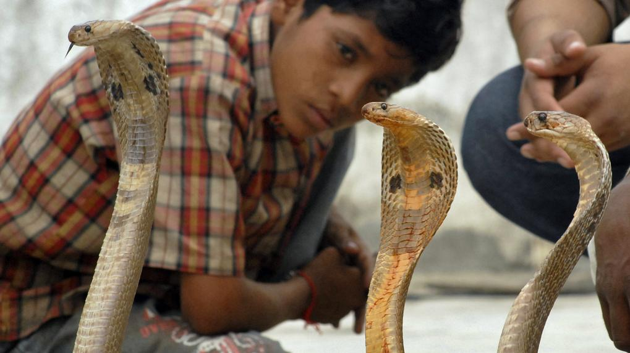
HOW MANY HUMANS HAVE DIED FROM A COBRA BITE?
20,000 people have died from a king cobra bite.

Slide 7
Can you keep a king cobra as a pet in the U.K?
King cobras, rattlesnakes and pit vipers are being sold openly at pet shops, posing a risk to public safety, vets and experts warn. Current laws in the UK mean no licence is needed to buy snakes that's capable of killing with just a single bite.

Slide 8
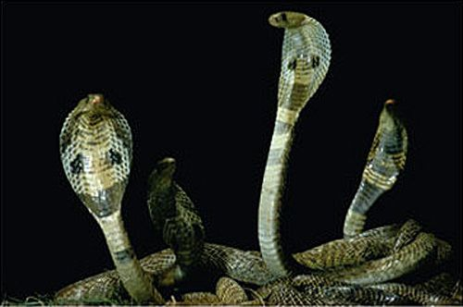
DO KING COBRAS TRAVEL IN GROUPS?
A Group of King Cobras is called a 'Quiver'. Despite the King Cobras fearsome reputation, it is generally a shy and reclusive animal, avoiding confrontation with people as much as possible.

Slide 9
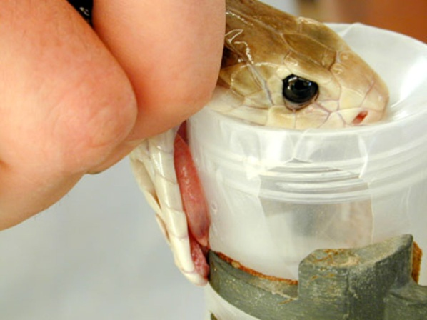
IS THERE AN ANTIDOTE FOR A KING COBRA BITE?
Tiger Snake Anti-venom is the preferred anti-venom in treating King Cobra bites.

Slide 10
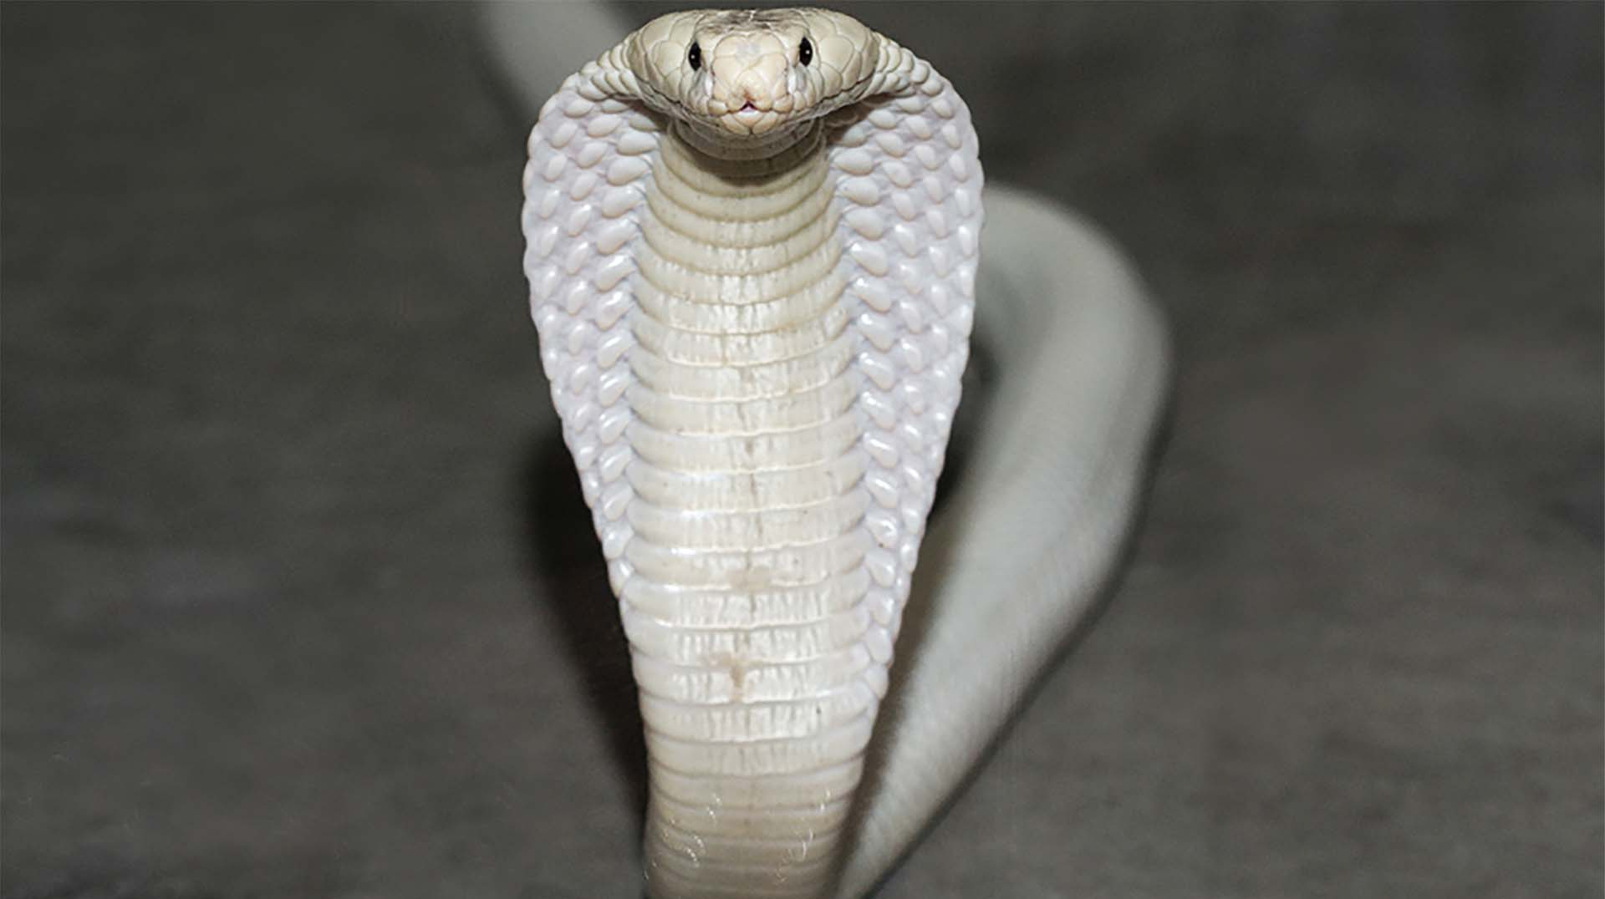
ARE KING COBRAS ENDANGERED?
Sustained loss of habitat has now placed the king cobra, on the 'endangered' list.

Slide 11
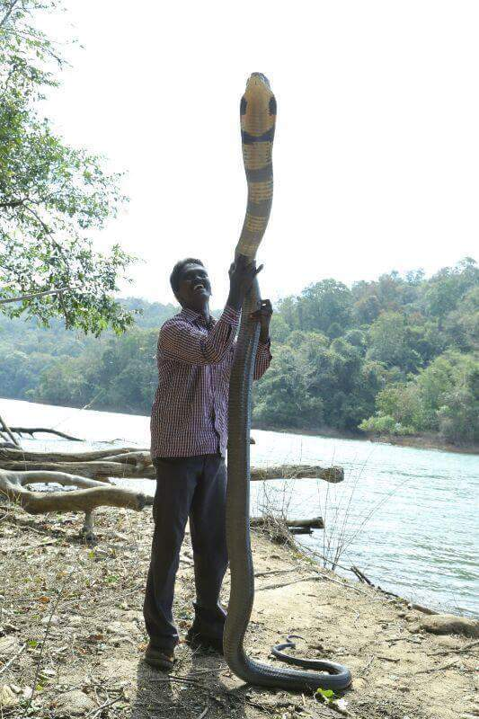
WHAT WAS THE SIZE OF THE BIGGEST KING COBRA ?
Adult king cobras are 3.18 to 4 m (10.4 to 13.1ft) long.
The longest known individual
measured 5.85 m (19.2 ft).

Slide 12
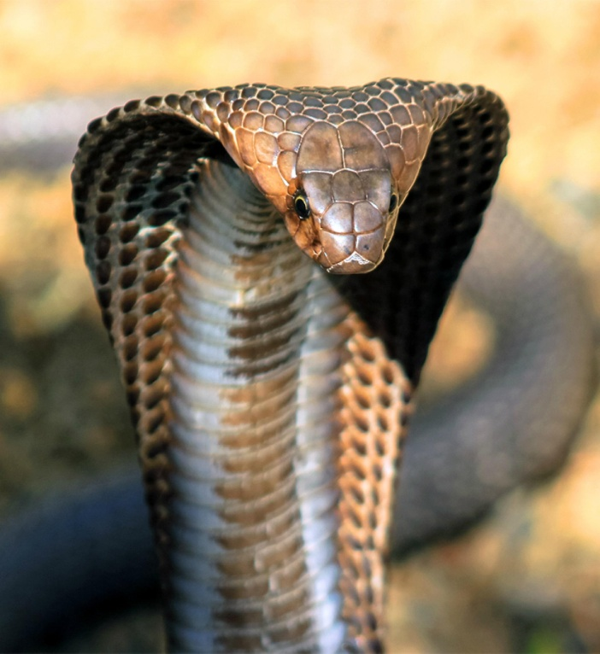
ARE KING COBRAS EVEN COBRAS?
Cobras are Elapids, a type of poisonous snake with hollow fangs fixed to the top jaw at the front of the mouth. These snakes cannot hold their fangs down on prey so they inject venom through their fangs

Slide 13
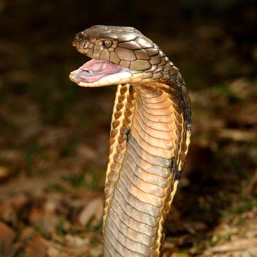
ARE KING COBRAS AGGRESIVE?
The short answer is yes. King cobras pack a potent venom mostly made up of neurotoxins, and a single bite from one of these snakes could be fatal. However, when confronted, king cobras will usually attempt to escape rather than attack and will only become aggressive if continuously provoked.

Slide 14
King cobra facts
Did you know king cobras growl?
King cobras are most active in day time.
Their venom attacks the nervous system.
Male king cobras wrestle.
There scientific name is: Ophiophagus Hannah

Slide 15
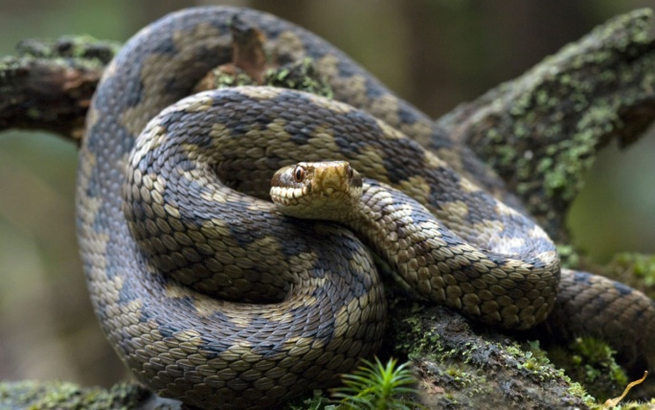
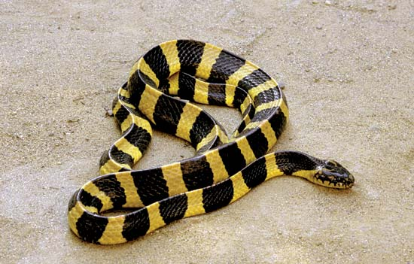
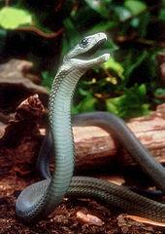
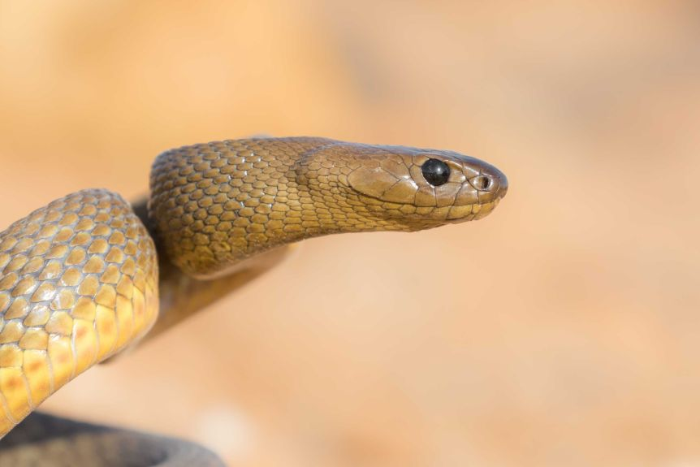
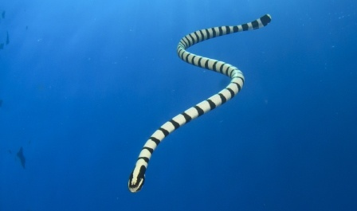
King cobra cousins
The king cobras relatives are Taipans, Adders, Mambas, and many sea snakes including Kraits.

Slide 16
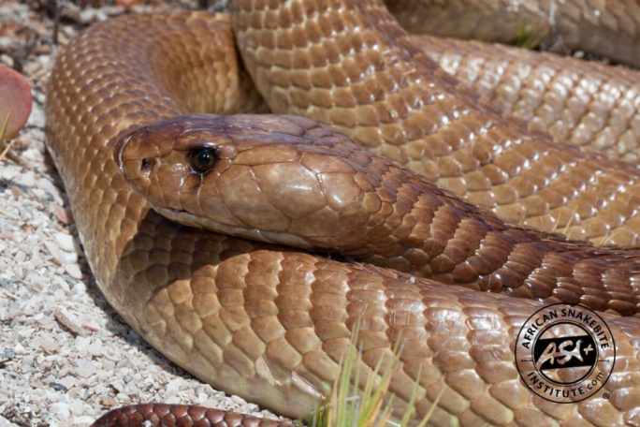
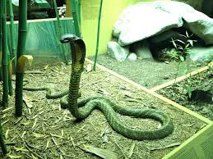
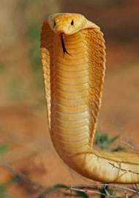
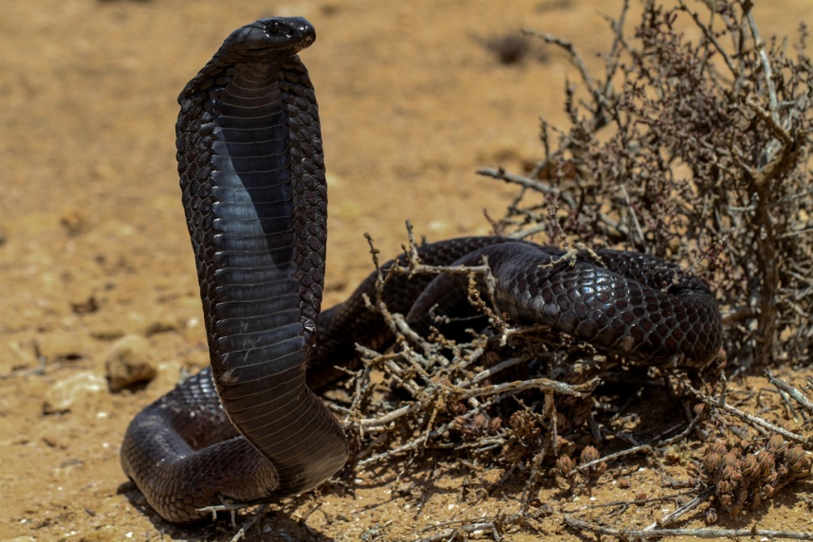
WHAT COLOURS CAN A KING COBRA BE?
A full-grown king cobra is yellow, green, brown or black.

Slide 17
Thanks for watching

