Slide 1
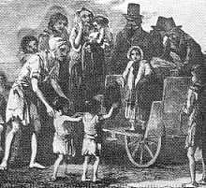
THE IRISH FAMINE
BY ESTELA BABARSKAITE P7

Slide 2
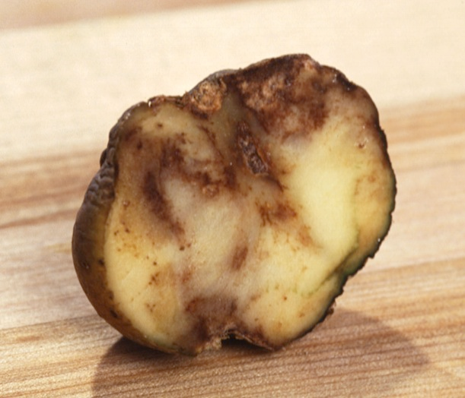
THE POATAO FAMINE
.The potato famine of 1846 to 1852 hit Ireland and Scotland. Many poor people grew potatoes for food. Potatoes grew on poor soil, even in wet and cold conditions.
. When a potato disease (blight) arrived, possibly in ships from America, it was a disaster. Potatoes went rotten, and were not fit to eat. People went hungry. More than 1 million people starved to death. Many more got sick.
. Nearly one million Irish people died and 1.5–2 million emigrated, and as many as two million immigrated to countries such as the United States.

Slide 3
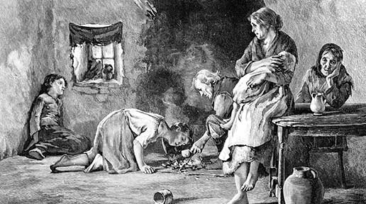
THE HUNGER
.Blight ruined potatoes in Scotland too. Many people there also starved in the 'Great Hunger’.

Slide 4
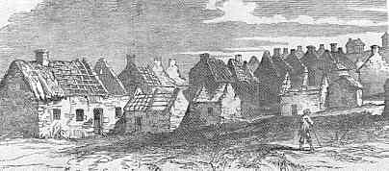
After the Famine
.Hunger continued to be a problem for Ireland in the years after the Famine. The poor still lived as tenants-at-will, subject to the whim of the landlord. Any improvements they made to the land still became the property of the landlord upon eviction.
. In 1879, the blight returned in force bringing the possibility of renewed starvation and further evictions in the west of Ireland. But by this time, farmers throughout Ireland had become politically organized.

Slide 5
THANK YOU FOR LISTENING

