Slide 1
great IRISH FAMINE
The Fields Of Athenry.

Slide 2
Causes
The Great Irish Famine began in 1845 when a disease called “blight” caused the potato crop to fail.
Most Irish people were extremely poor and depended on potatoes for all of their food .
This led to starvation for most people.

Slide 3
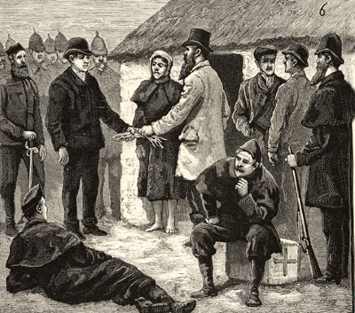
Landlords
British Landlords owned most of the land and rented it to poor Irish farmers.
When the potato blight struck they showed no mercy towards their tenants.
They still expected them to pay rent even though they had no money for food and were starving.
After eviction, people ended up in
workhouses.

Slide 4
The Fields Of Athenry
The Fields Of Athenry is a famous song that tells the story of a poor family during the Famine.
A father named Michael stole some corn from his landlord whose name was Charles Trevelyan to feed his starving family.
He was arrested and sent to Botany Bay in Australia, thousands of miles away and never saw his wife or children again.

Slide 5
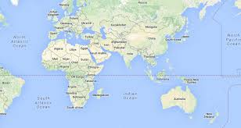

Slide 6
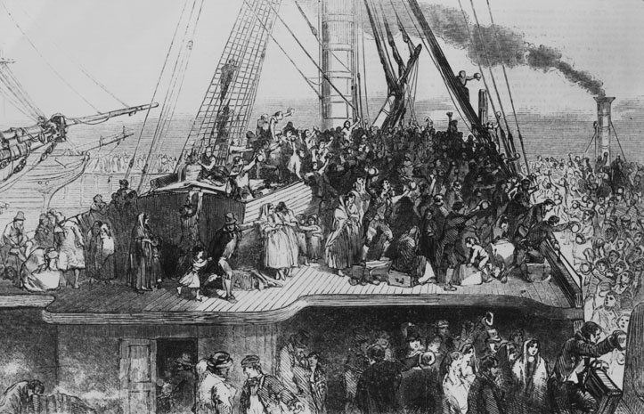
The Fields Of Athenry
It’s a sad song that tells a sad story about a tragic time in Irish history.
1 million people died and another million emigrated.
Lots of them went to America on ships that became known as Coffin Ships.

Slide 7
The Fields Of Athenry
In recent years the song has become an anthem at all major Irish sporting events.
People all around the world associate the song with Ireland.
Liverpool fans even changed the words to “The Fields Of Anfield Road”

Slide 8
The Fields Of Athenry
Even though its a sad song it has now become a happy song for many Irish people all around the world.

Slide 9
THANKYOU
By Kaitlin Gallagher!!

